Slide 1
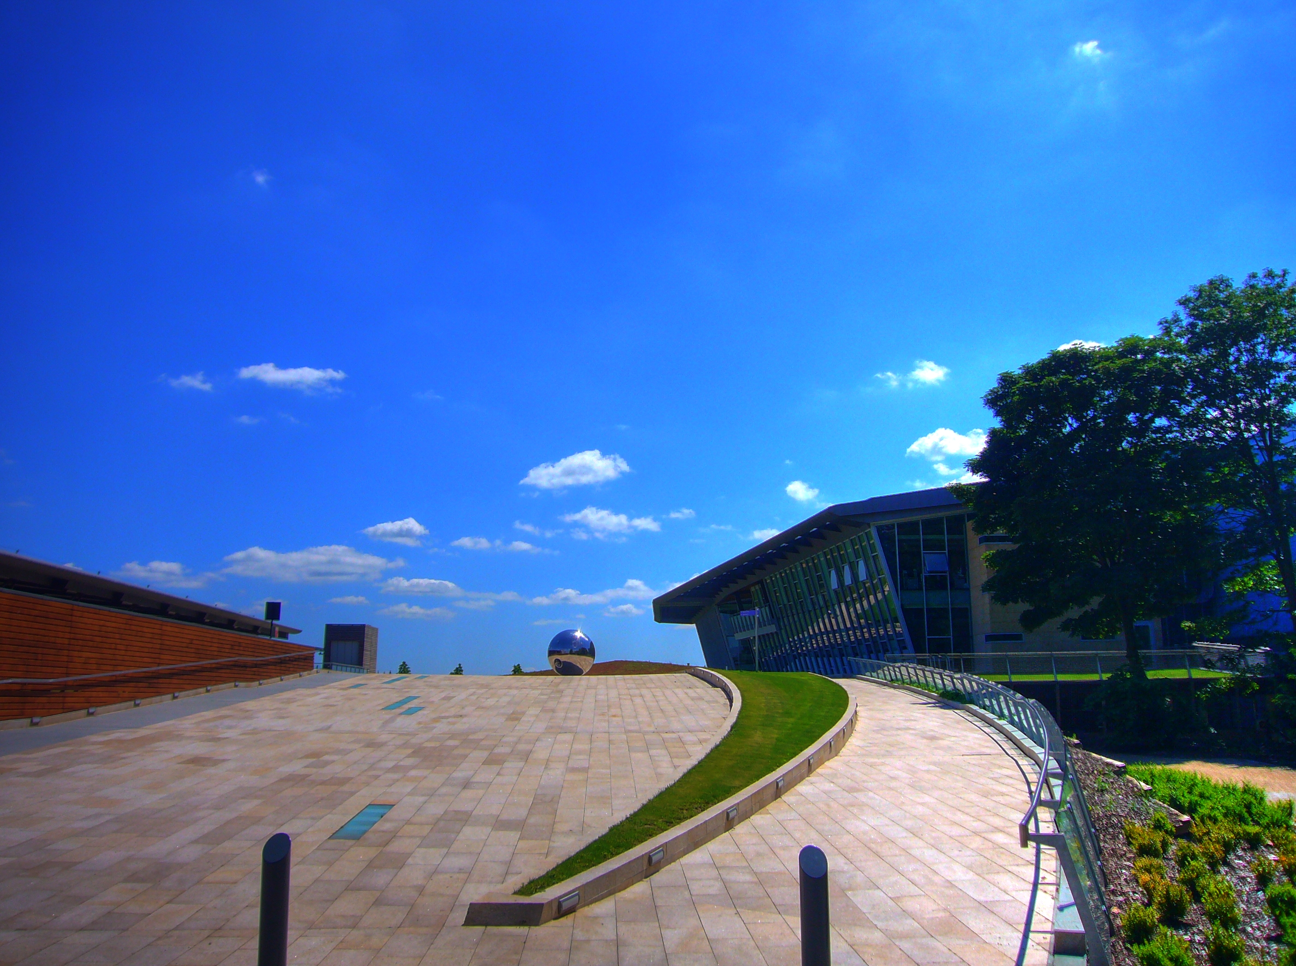

Lecture 2 : Basic tools and formats in bioinformatics
Volos Summer School
30 / 05 / 2017
Arthur Gilly

Slide 2
Data input
The GWAS analysis pipeline
Tools
Genotyping machine software(illumina)
Measuring intensities
iDAT
calling
genCall/ zCall
BED
Variant QC
PLINK
BED
Sample QC
PLINK/R/eigenSoft
BED
Association
Study-specific
PLINK / SNPTEST / GEMMA
association file (program-specific)

Slide 3
Data input
The (imputed) GWAS analysis pipeline
Genotyping machine software(illumina)
Measuring intensities
iDAT
calling
genCall/ zCall
BED
Variant QC
PLINK
Study-specific
IMPUTE2/online (HRC)
BED
BED
imputation
Sample QC
PLINK/R/eigenSoft
Program-specific (VCF, Oxford)
Imputation QC
Association
Study-specific
PLINK / SNPTEST / GEMMA
PLINK
BED
association file
(program-specific)

Slide 4
Genotyping data calling

Slide 5
Data input
Intensities: what intensities?

Slide 6
Data input
Intensities: the good and the bad

Slide 7
Data input
Intensities: the good and the bad
✔
✘

Slide 8
Genotyping data storage

Slide 9
Data input
Which data types do we need?

Slide 10
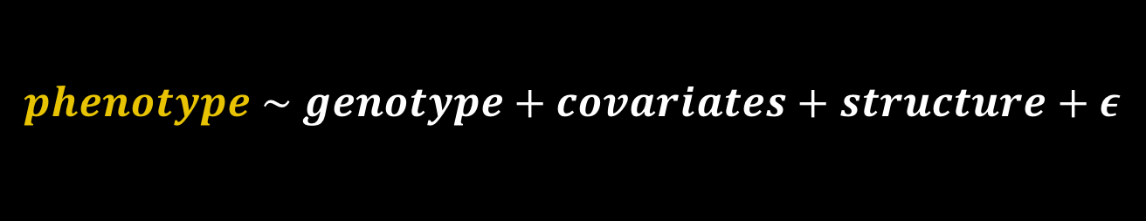
Data input
Which data types do we need?
$$phenotype \sim genotype+covariates+structure+ε$$

Slide 11
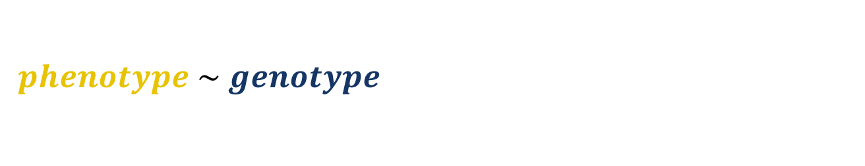
Data input
Which data types do we need?
$$phenotype \sim genotype+covariates+structure+ε$$

Slide 12
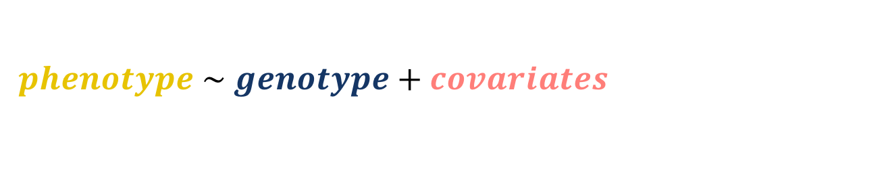
Data input
Which data types do we need?
$$phenotype \sim genotype+covariates+structure+ε$$

Slide 13

Data input
Which data types do we need?
$$phenotype \sim genotype+covariates+structure+ε$$

Slide 14
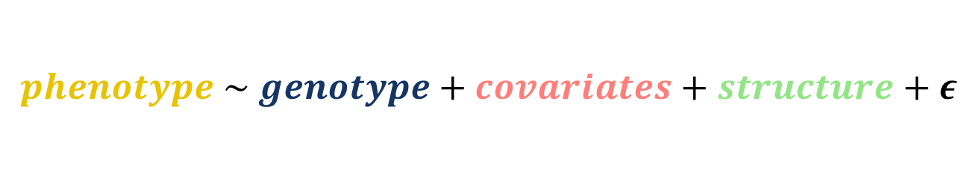
Data input
Which data types do we need?
$$phenotype \sim genotype+covariates+structure+ε$$

Slide 15
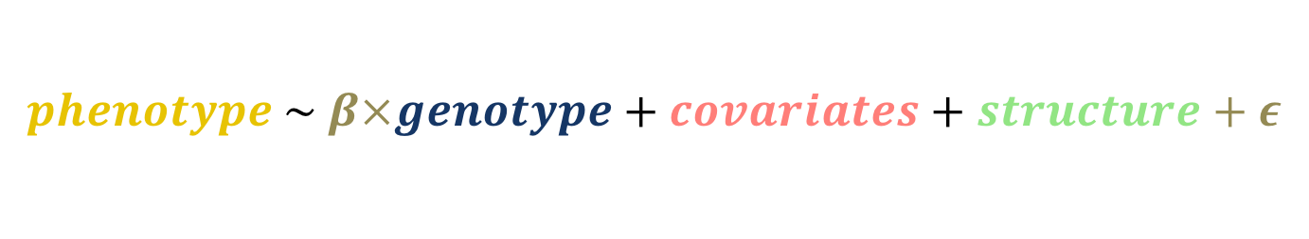
Data input
Which data types do we need?
$$phenotype \sim β×genotype+covariates+structure+ε$$

Slide 16

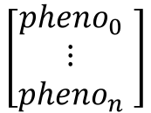
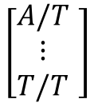
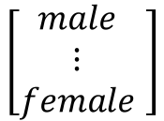
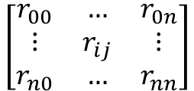
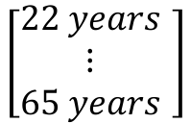
Data input
Which data types do we need?
$$phenotype \sim β×genotype+covariates+ structure+ε$$
$$\left[\begin{matrix}pheno_{0} \\ ⋮ \\ pheno_{n}\end{matrix} \right]$$
$$\left[\begin{matrix}A/T \\ ⋮ \\ T/T\end{matrix} \right]$$
$$\left[\begin{matrix}male \\ ⋮ \\ female\end{matrix} \right]$$
$$\left[\begin{matrix}22 years \\ ⋮ \\ 65 years\end{matrix} \right]$$
$$\left[\begin{matrix}r_{00} & … & r_{0n} \\ ⋮ & r_{ij} & ⋮ \\ r_{n0} & … & r_{nn}\end{matrix}\right]$$

Slide 17
Data input
Which data types do we need?
$$phenotype \sim β×genotype+covariates+ structure+ε$$
As we go from variant to variant…
$$\left[\begin{matrix}pheno_{0} \\ ⋮ \\ pheno_{n}\end{matrix} \right]$$
$$\left[\begin{matrix}A/T \\ ⋮ \\ T/T\end{matrix} \right]$$
$$\left[\begin{matrix}male \\ ⋮ \\ female\end{matrix} \right]$$
$$\left[\begin{matrix}22 years \\ ⋮ \\ 65 years\end{matrix} \right]$$
$$\left[\begin{matrix}r_{00} & … & r_{0n} \\ ⋮ & r_{ij} & ⋮ \\ r_{n0} & … & r_{nn}\end{matrix}\right]$$

Slide 18
Data input
Which data types do we need?
$$phenotype \sim β×genotype+covariates+ structure+ε$$
As we go from variant to variant…
$$\left[\begin{matrix}pheno_{0} \\ ⋮ \\ pheno_{n}\end{matrix} \right]$$
$$\left[\begin{matrix}A/T \\ ⋮ \\ T/T\end{matrix} \right]$$
$$\left[\begin{matrix}male \\ ⋮ \\ female\end{matrix} \right]$$
$$\left[\begin{matrix}22 years \\ ⋮ \\ 65 years\end{matrix} \right]$$
$$\left[\begin{matrix}r_{00} & … & r_{0n} \\ ⋮ & r_{ij} & ⋮ \\ r_{n0} & … & r_{nn}\end{matrix}\right]$$
These stay constant (they describe the samples)

Slide 19
Data input
Which data types do we need?
$$phenotype \sim β×genotype+covariates+ structure+ε$$
As we go from variant to variant…
$$\left[\begin{matrix}pheno_{0} \\ ⋮ \\ pheno_{n}\end{matrix} \right]$$
$$\left[\begin{matrix}A/T \\ ⋮ \\ T/T\end{matrix} \right]$$
$$\left[\begin{matrix}male \\ ⋮ \\ female\end{matrix} \right]$$
$$\left[\begin{matrix}22 years \\ ⋮ \\ 65 years\end{matrix} \right]$$
$$\left[\begin{matrix}r_{00} & … & r_{0n} \\ ⋮ & r_{ij} & ⋮ \\ r_{n0} & … & r_{nn}\end{matrix}\right]$$
These stay constant (they describe the samples)
This one changes

Slide 20
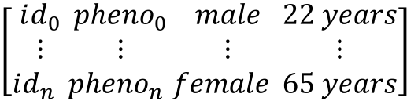
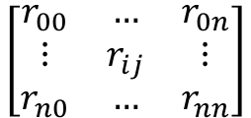
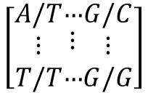
Data input
Our first format: TPED
$$\left[\begin{matrix}id_{0} \\ ⋮ \\ id_{n} \end{matrix}\begin{matrix}pheno_{0} \\ ⋮ \\ pheno_{n }\end{matrix}\begin{matrix}male \\ ⋮ \\ female \end{matrix}\begin{matrix}22 years \\ ⋮ \\ 65 years\end{matrix}\right]$$
$$\left[\begin{matrix}r_{00} & … & r_{0n} \\ ⋮ & r_{ij} & ⋮ \\ r_{n0} & … & r_{nn}\end{matrix}\right]$$
FAM/TFAM file
Matrix file
(program-specific)
all
variants
$$\left[\begin{matrix}A/T \\ ⋮ \\ T/T\end{matrix}\begin{matrix}… \\ ⋮ \\ …\end{matrix}\begin{matrix}G/C \\ ⋮ \\ G/G\end{matrix}\right]$$
all
individuals
TPED file

Slide 21
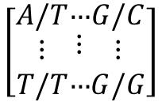
Data input
Our first format: TPED
$$\left[\begin{matrix}id_{0} \\ ⋮ \\ id_{n} \end{matrix}\begin{matrix}pheno_{0} \\ ⋮ \\ pheno_{n }\end{matrix}\begin{matrix}male \\ ⋮ \\ female \end{matrix}\begin{matrix}22 years \\ ⋮ \\ 65 years\end{matrix}\right]$$
One of PLINK’s traditional formats
Not used in practice
Convenient for looping over SNPs
Input --tfile
Output --recode transpose
FAM/TFAM file
FAMILY1 SAMPLE1 0 0 1 22 1.5
FAMILY2 SAMPLE2 0 0 2 65 2.1
all
variants
$$\left[\begin{matrix}A/T \\ ⋮ \\ T/T\end{matrix}\begin{matrix}… \\ ⋮ \\ …\end{matrix}\begin{matrix}G/C \\ ⋮ \\ G/G\end{matrix}\right]$$
1 rs15933 0 752721 A G G G
1 1:846808 0 846808 C C T C
all
individuals
TPED file

Slide 22
Data input
Another format: PED/MAP
FAMILY1 SAMPLE1 0 0 1 1.5 A G C C
FAMILY2 SAMPLE2 0 0 2 2.1 T T A A
One of PLINK’s traditional formats
Not used in practice
Convenient for looping over samples
Input --file
Output --recode
FAM/TFAM file
PED file
all
ind
$$\left[\begin{matrix}A/T \\ ⋮ \\ T/T\end{matrix}\begin{matrix}… \\ ⋮ \\ …\end{matrix}\begin{matrix}G/C \\ ⋮ \\ G/G\end{matrix}\right]$$
1 rs15933 0 752721
1 1:846808 0 846808
all
individuals
MAP file

Slide 23
Data input
Exercise 1 : Format conversion
In /Workshop_data/Lecture2/Exercise1
Convert cohort1.tped/tfam to cohort1.ped/map
Use the transpose.sh script provided or try to d.i.y
Convert the file to PED using PLINK
Compare both files using diff
FAMILY1 SAMPLE1 0 0 1 1.5 A G C C
FAMILY2 SAMPLE2 0 0 2 2.1 G G T C

Slide 24
Data input
Exercise 1 : Solution
cut -d' ' -f1-4 cohort1.tped | tr ' ' '\t'> cohort1.map
paste -d' ' cohort1.tfam <(./transpose.sh <(cut -d' ' -f5- cohort1.tped)) > cohort1.ped
plink --tfile cohort1 --recode --out fortest
diff cohort1.ped fortest.ped

Slide 25
Data input
Exercise 2 : Storage
Consider 3 different genotyping chips
500,000 SNPs (Illumina OmniExpress)
1,000,000 SNPs (ExomeChip)
2,500,000 SNPs (Illumina Onmi 2.5)
How large is a PED file containing genetic information for10,000 samples on each of these chips?

Slide 26
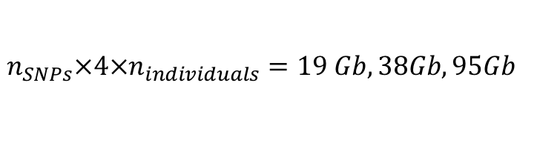
Data input
Exercise 2 : Storage
Consider 3 different genotyping chips
500,000 SNPs (Illumina OmniExpress)
1,000,000 SNPs (ExomeChip)
2,500,000 SNPs (Illumina Onmi 2.5)
1 character = 1 byte
Each genotype = 2 alleles + 2 spaces = 4 characters
$$n_{SNPs}×4×n_{individuals}=19 Gb, 38Gb, 95Gb$$

Slide 27
Data input
Binary formats
1 character = 1 byte
Each genotype = 2 alleles + 2 spaces = 4 characters
Can we make this better?

Slide 28

Data input
Binary formats
1 character = 1 byte
Each genotype = 2 alleles + 2 spaces = 4 characters
Can we make this better?
2 solutions
Compress using ZIP/GZIP
Use binary formats
A |  | G
$$×n_{individuals}$$
1 | 0 | 0 | 0 | 0 | 0 | 1
0 | 1 | 0 | 0 | 0 | 0 | 0
1 | 0 | 0 | 0 | 1 | 1 | 1

Slide 29
Data input
Binary formats
1 character = 1 byte
Each genotype = 2 alleles + 2 spaces = 4 characters
Can we make this better?
2 solutions
Compress using ZIP/GZIP
Use binary formats
A |  | G
$$×n_{individuals}$$
0
1
Question: how smaller is the size now?

Slide 30
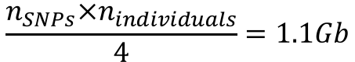
Data input
Binary formats
1 character = 1 byte
Each genotype = 2 alleles + 2 spaces = 4 characters
Can we make this better?
2 solutions
Compress using ZIP/GZIP
Use binary formats
A |  | G
$$×n_{individuals}$$
0
1
Question: how smaller is the size now?
$$\frac{n_{SNPs}×n_{individuals}}{4}=1.1Gb$$

Slide 31
Data input
One (binary) format to rule them all : BED/BIM/FAM
FAMILY1 SAMPLE1 0 0 1 22 1.5
FAMILY2 SAMPLE2 0 0 2 65 2.1
1 rs15933 0 564862 C T
1 1:752566 0 752566 G A
FAM/TFAM file
BIM file
10101111 10101111 10100010 10111011 10101000 10000000
00101011 00100000 10101000 10001011 00000011 11111111
11111111 11111111 11111111 11111110 11111111 11111111
11111111 11111110 11111110 11111110 11101111 11111111
BED file
Input: --bfile
Output: --make-bed
Do not open a BED file with less, cat, head, or tail !
If you absolutely want to look, xxd –b or od -c

Slide 32
Genotyping data : common operations

Slide 33
Common operations
Sample management
--keep [file] | Keep samples in file
--remove [file] | Remove samples in file
SNP management
--extract [file] | Keep SNPs in file
--exclude [file] | Remove SNPs in file
Extracting regions
--chr [name] | Extract data on specified chromosome
--from-bp [pos] | From specified position
--to-bp [pos] | To specified position

Slide 34
Common operations
Variant QC
--maf [threshold] | Keep variants with MAF>threshold
--hwe midp [threshold] | Keep variants with HWE p>threshold
Sample QC
--missing | Compute per-sample and per-variant missingness
--check-sex | Check sexes by looking at chrX
--genome | Compute relatedness, check for duplicates

Slide 35
Linkage disequilibrium

Slide 36
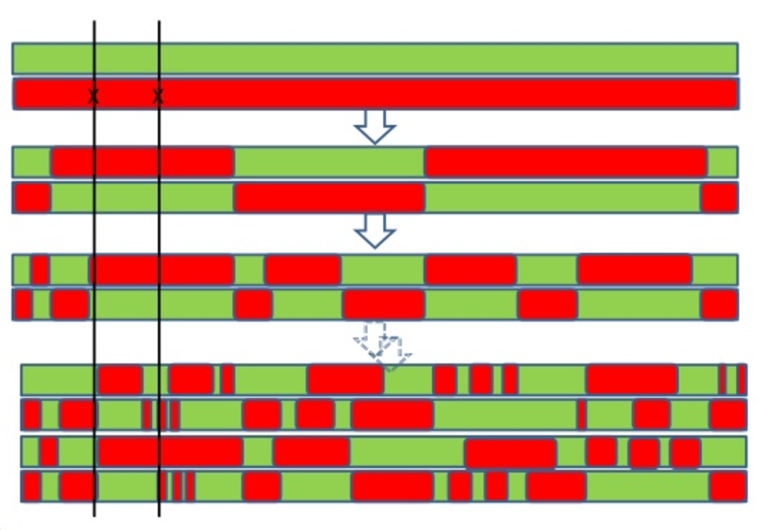
LD
The strange beautiful world of linkage disequilibrium

Slide 37
LD
The strange beautiful world of linkage disequilibrium

Slide 38
LD
The strange beautiful world of linkage disequilibrium

Slide 39
LD
LD between 2 or more SNPs
plink --r2 --ld-snps rs1234,rs4567
plink --r2 --ld-snp-list [file]
Pairwise LD in a region
plink --r2 --ld-window 10 --ld-window-kb 1000 --ld-window-r2 0.2
LD-pruning (only independent SNPs)
plink --indep 50 5 2
plink --indep-pairwise 50 5 0.2
Plink --indep-pairphase 50 5 0.2

Slide 40
Stretching the PLINK muscle
Exercise 3 : Stretching the PLINK muscle
In /Workshop_data/Lecture2/Exercise3
How many common (MAF>5%) variants are there on chromosome 11 in the `cohort1` dataset?
How many variants are in LD (r2>0.4) with 21:28759840 on chromosome 21 in a 1Mbp window?

Slide 41
Stretching the PLINK muscle
Exercise 3 : Stretching the PLINK muscle
plink --bfile cohort1 --maf 0.05 --chr 11 --out chr11
wc –l chr11.bim
plink --bed cohort1.bed --bim cohort1.bim --fam cohort1.fam --r2 --ld-snp 21:28759840 --ld-window-kb 1000000 --ld-window 1000000 -ld-window-r2 0.4
wc –l plink.ld

Slide 42
QC steps

Slide 43
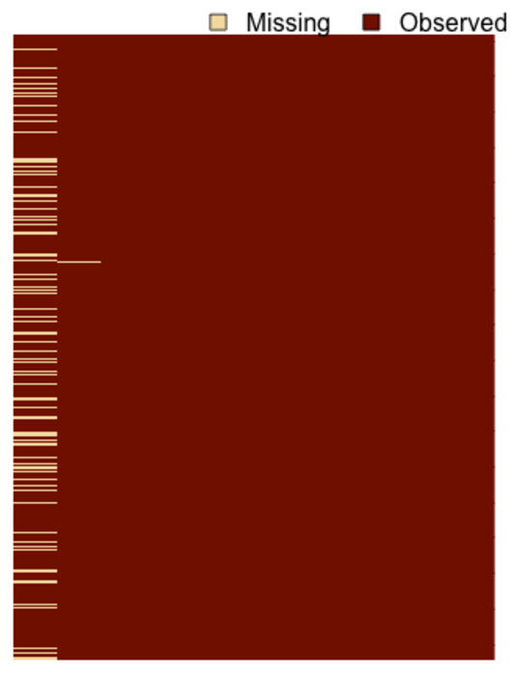
QC
Variant QC: which variants do we want to remove?

Slide 44
QC
Variant QC: which variants do we want to remove?
Calling is not perfect: some genotypes are missing

Slide 45
QC
Variant QC: which variants do we want to remove?
Calling is not perfect: some genotypes are missing
If we see that 40% of all alleles are a, what is the proportion of aa, Aa, AA?

Slide 46
QC
Variant QC: which variants do we want to remove?
Calling is not perfect: some genotypes are missing
Variants violating Hardy-Weinberg equilibrium are improbable

Slide 47
QC
Variant QC: which variants do we want to remove?
Calling is not perfect: some genotypes are missing
Variants violating Hardy-Weinberg equilibrium are improbable

Slide 48
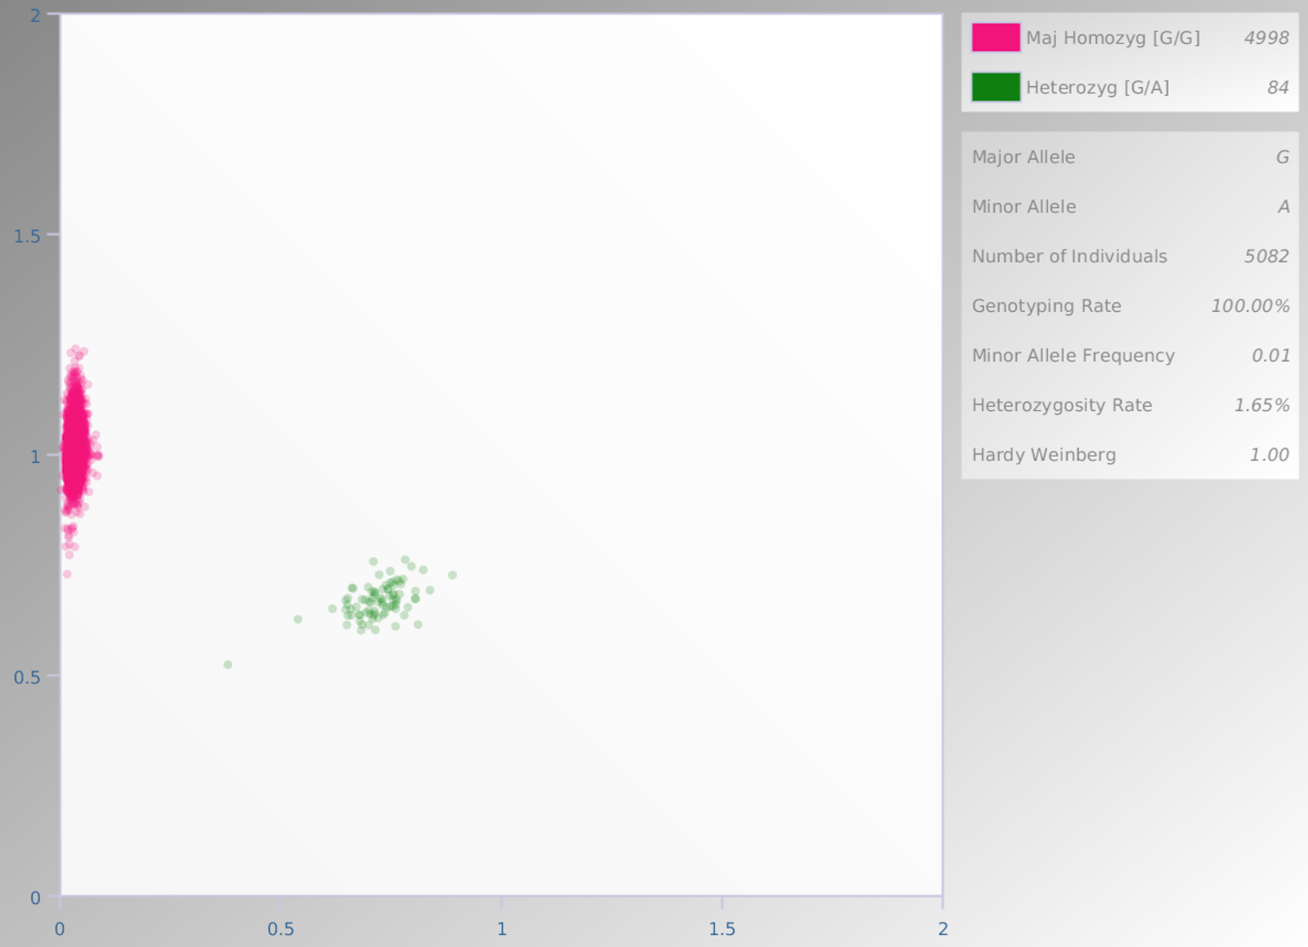
QC
Variant QC: which variants do we want to remove?
Calling is not perfect: some genotypes are missing
Variants violating Hardy-Weinberg equilibrium are improbable
Rare variants are difficult to call

Slide 49
QC
Sample QC: which individuals do we want to remove?
All the different ways in which our samples could be the wrong ones
What are some defining sample characteristics?

Slide 50
QC
Sample QC: which individuals do we want to remove?
All the different ways in which our samples could be the wrong ones
What are some defining sample characteristics?

Slide 51
QC
Sample QC: which individuals do we want to remove?
All the different ways in which our samples could be the wrong ones
What are some defining sample characteristics?

Slide 52
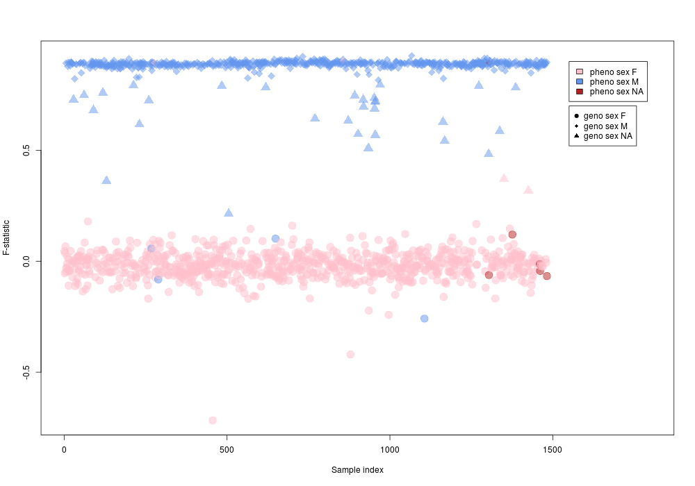
QC
Sample QC: which individuals do we want to remove?
All the different ways in which our samples could be the wrong ones
Sex checks
Ethnicity checks

Slide 53
QC
Sample QC: which individuals do we want to remove?
All the different ways in which our samples could be the wrong ones
Sex checks
Ethnicity checks

Slide 54
QC
Sample QC: which individuals do we want to remove?
All the different ways in which our samples could be the wrong ones

Slide 55
QC
Sample QC: which individuals do we want to remove?
All the different ways in which our samples could be the wrong ones
SAMPLE DUPLICATES

Slide 56
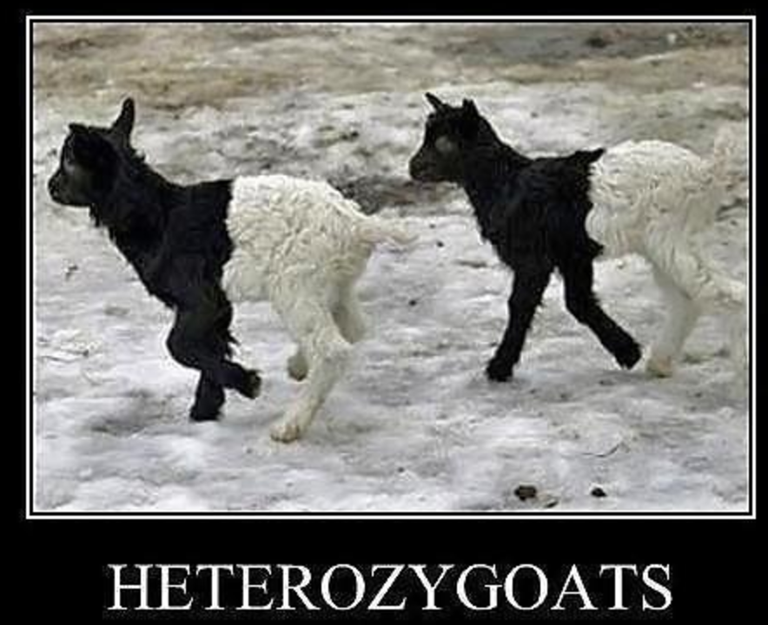
QC
Sample QC: which individuals do we want to remove?

